Slide 1
Smart Shopping
Cameron L’Ecuyer – Class ID: 17 (Team Leader)
Sneha Mishra – Class ID: 21
Navya Pillala – Class ID: 26
Ruthvic Punyamurtula – Class ID: 30

Slide 2
Application’s Purpose
Allow users to view clothes using augmented reality, so they can “try them on” before they buy them, or go to the store
Primary technologies:
Body recognition
Face recognition
BMI calculation
Searching of various stores using APIs
Android mobile platform

Slide 3
Increment 1
The primary function was to explore and implement technologies that we would need to create our app
Technologies:
Body recognition
Face recognition
BMI calculator
Image recognition
Retailer search APIs

Slide 4
Successes
We found and implemented APIs for facial recognition, body recognition, and image recognition
BMI was determined that it would be relatively easy to implement without an API

Slide 5
Issues
The facial API we started with was not sufficient, so a new one was found
None of the retailer APIs worked or were available to us
Several members of the team had to travel out of the country
The team leader briefly forgot to discuss tasks and had to assign them late in the cycle

Slide 6
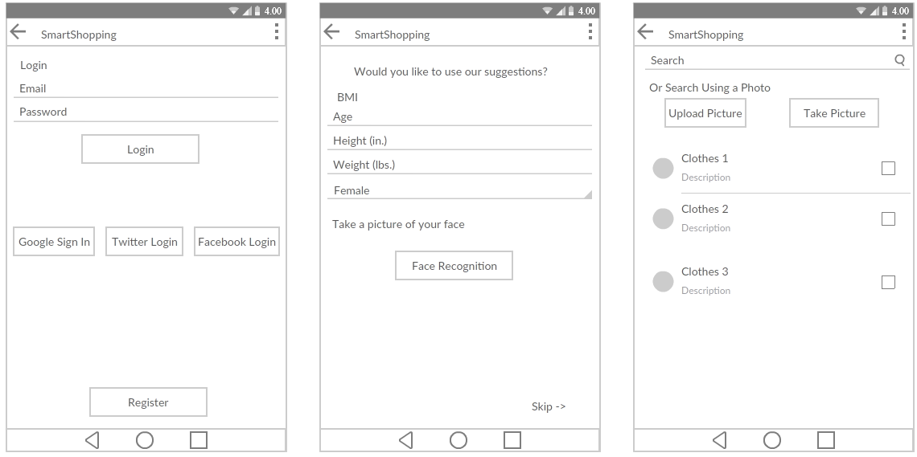
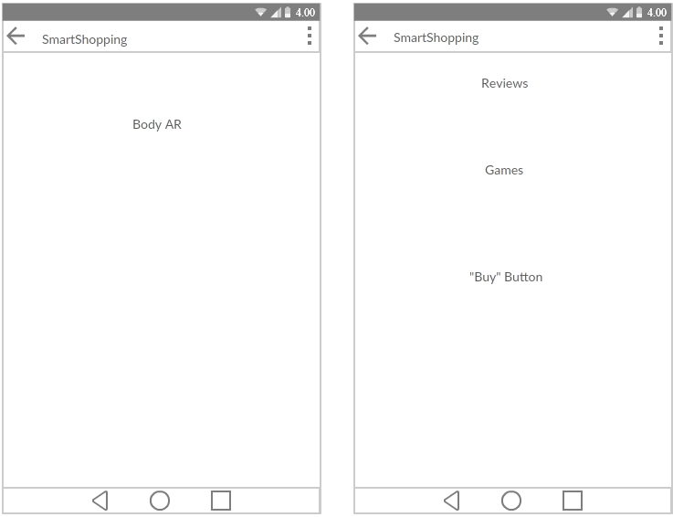
Increment 2 Goals
Integrate all the technologies together in Android
Create a static database for searching
Add more features to improve the app

